Slide 1

My Brain My Story
Lived experience of encephalitis
By Sam
Year 8

Slide 2
Today I will be talking about
2. My story
1. What is encephalitis?
3. How can you help me?

Slide 3
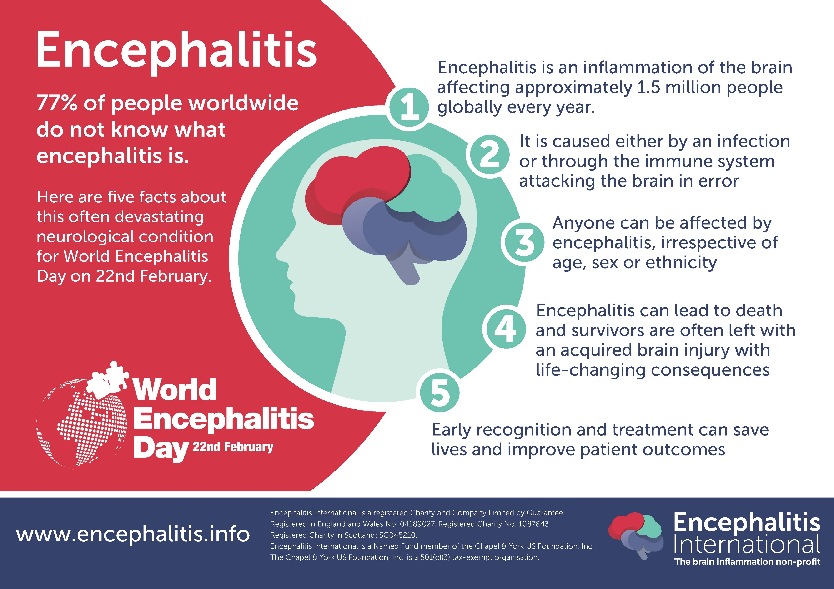
What is encephalitis?

Slide 4
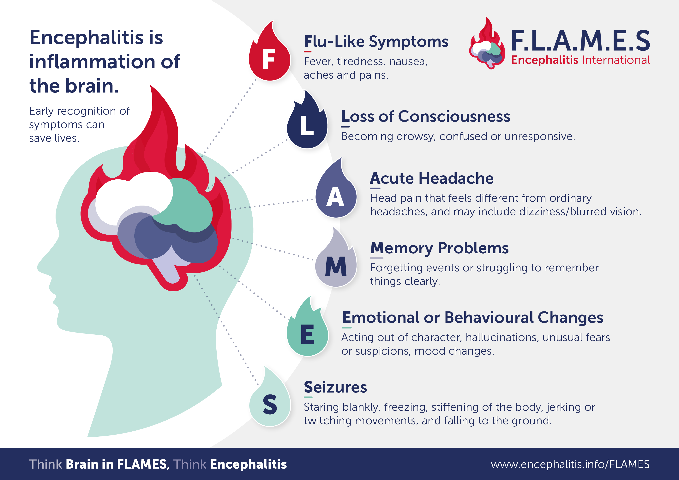
What is encephalitis?

Slide 5
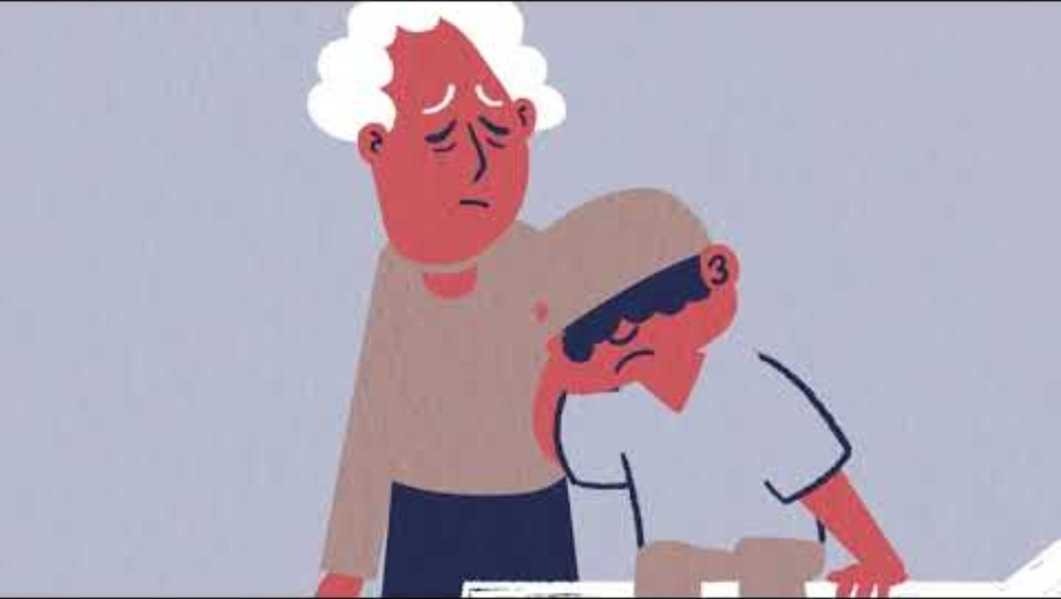
What is encephalitis?

Slide 6

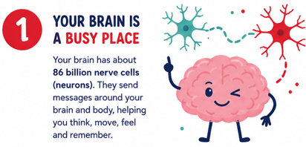
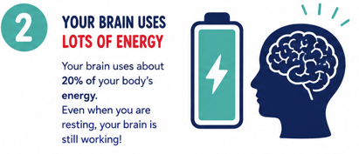

Slide 7
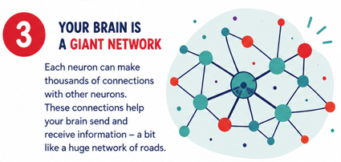
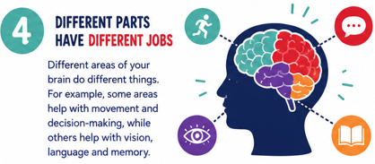

Slide 8

My story
When I was 9, I suddenly became very unwell with a high temperature, a terrible headache and confusion, and my family took me to hospital.
I became very sleepy and had a seizure, so the doctors did lots of tests to find out what was happening to my brain.
They diagnosed me with viral encephalitis, which meant that my brain had become inflamed because of a virus.
I was given medicine and stayed in hospital while the doctors and nurses looked after me and helped my brain and body recover.
After several weeks, I was well enough to leave hospital, although I was still very tired and needed plenty of rest at home.
I’m now 12, and although encephalitis was a big part of my life, I’m learning about what happened to me and getting back to doing the things I enjoy.
NOTE: This is an example. Please replace with your own story.

Slide 9
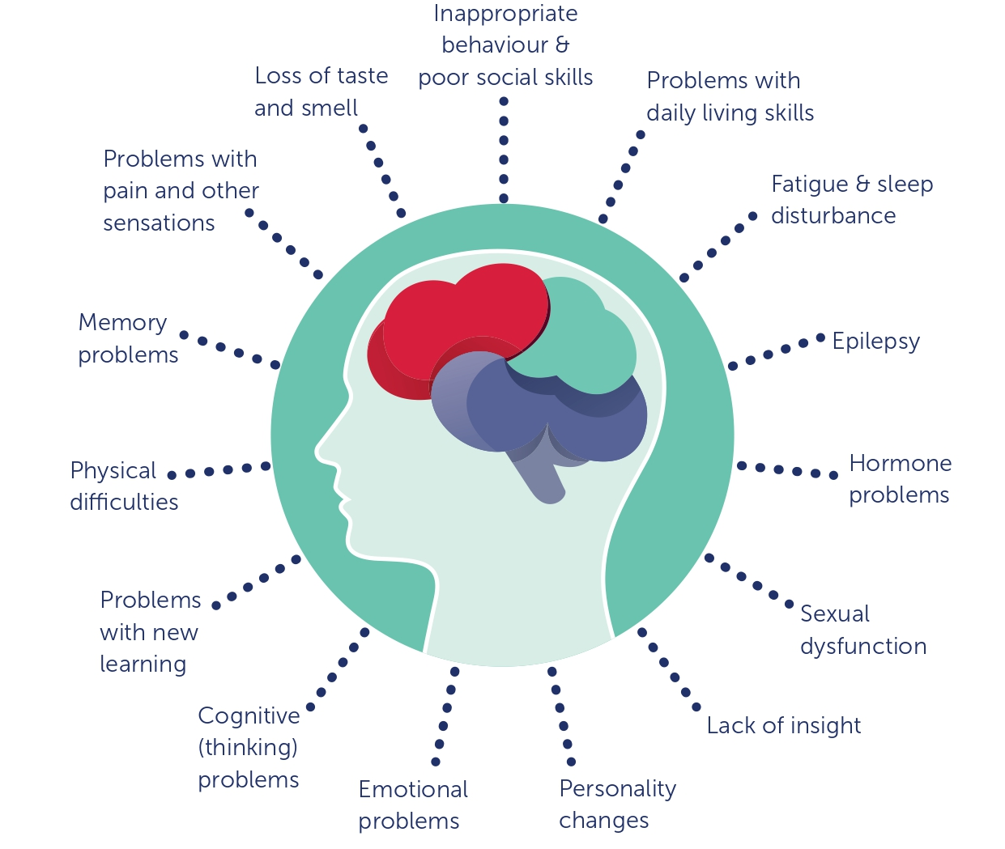
After Encephalitis
There are lots of changes that can happen after encephalitis
The ones that I often experience are…

Slide 10
After Encephalitis
Feeling very tired after normal activities
  If I have a busy day at school, I get tired and have to sleep when I get home.
Making new memories
  I can remember things from the past but sometimes I don’t remember new things that happen
Feeling angrier than I used to
  Sometimes I shout at my sister if she annoys me when I am tired
Seizures
  I have to take tablets everyday, so I don’t have any seizures

Slide 11
How can you help me?
3 things that would help me
Being patient with me if I forget something
Still invite me to do things
Ask me questions about encephalitis
Notes:
Here are some suggestions:
Be patient with me.
Talk slowly.

Slide 12

Notes:
Here are some suggestions:
Be patient with me.
Talk slowly.

Slide 13
Thank you for listening!
Any questions?

