Slide 1

My story with Encephalitis
By [X]
Year [X]

Slide 2
Today I will be talking about
1. My story
2. What is encephalitis?
3. How can you help me?

Slide 3

My story
[insert your photo]
I started feeling…
I was diagnosed with…
I left hospital when…

Slide 4

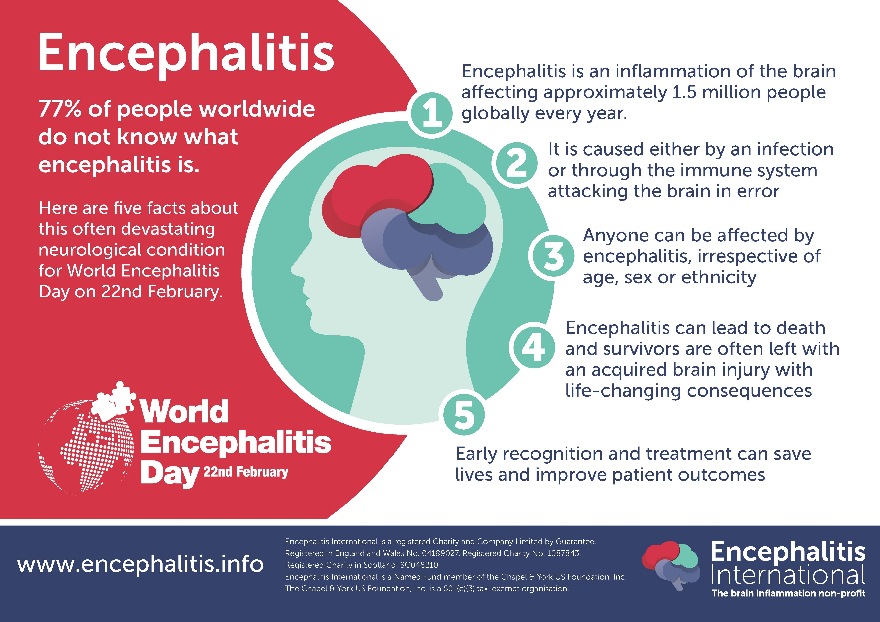
What is encephalitis?

Slide 5
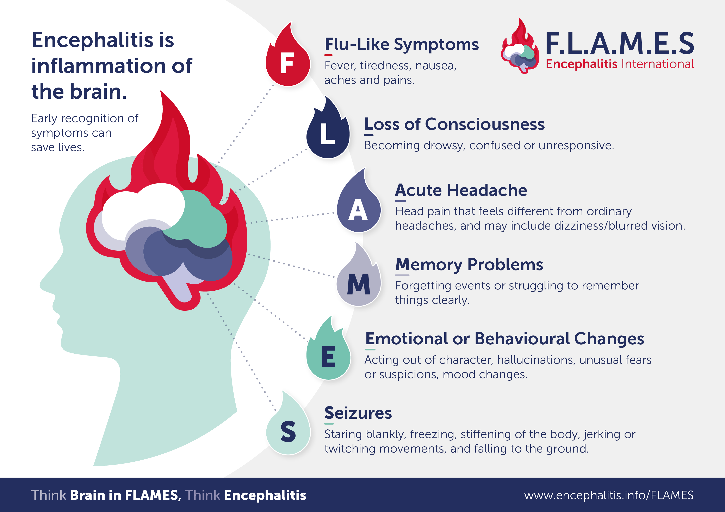
What is encephalitis?

Slide 6
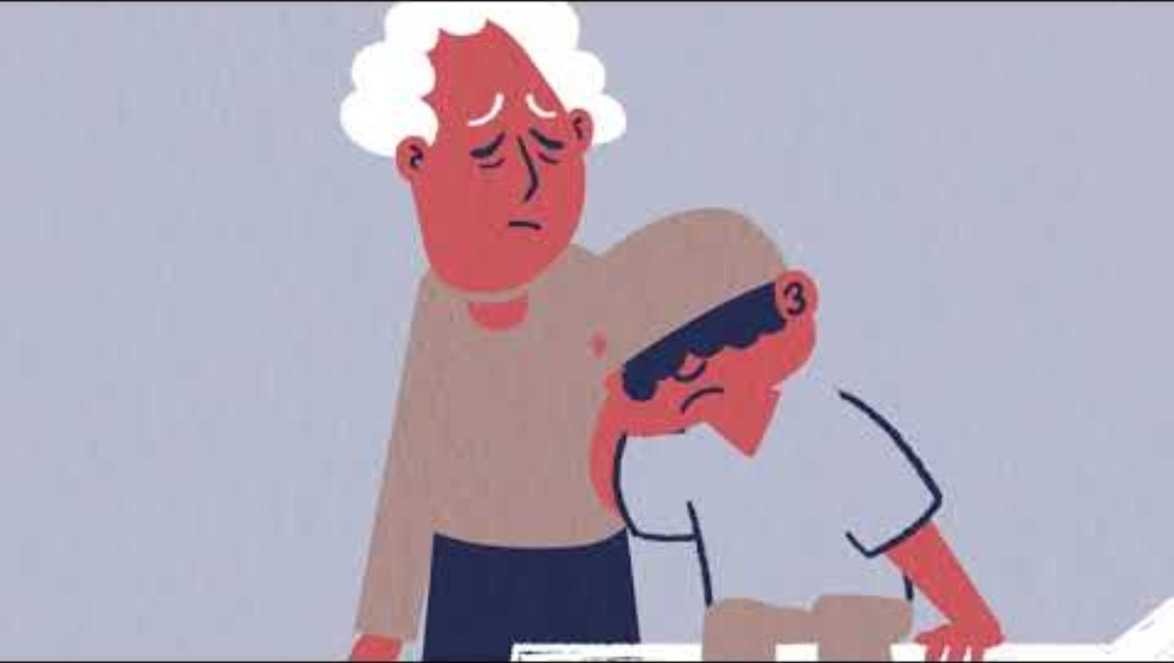
What is encephalitis?

Slide 7
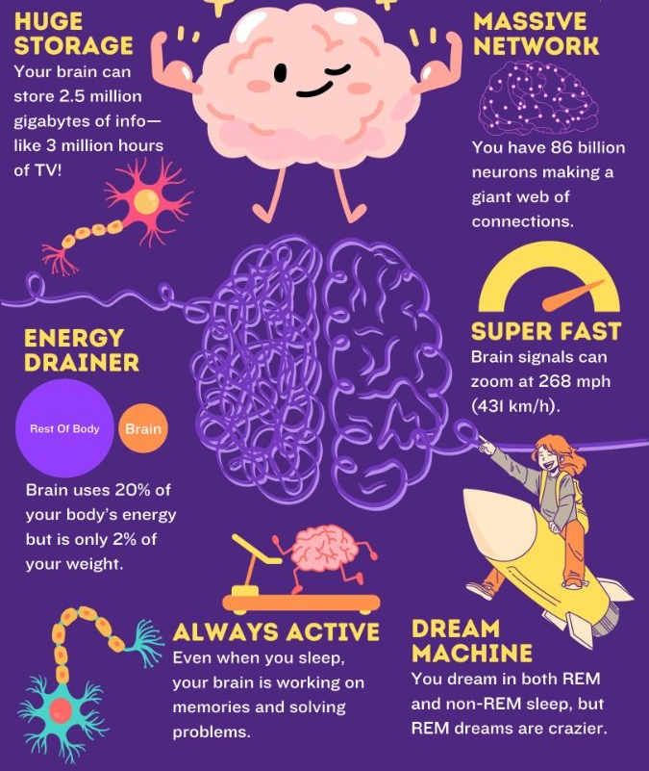
Facts about the brain
The brain is the body’s control centre
It controls everything you do, think, and feel
It controls both voluntary actions like moving your arm
and involuntary functions like breathing and heartbeat
Image source: Chirpy Pages

Slide 8

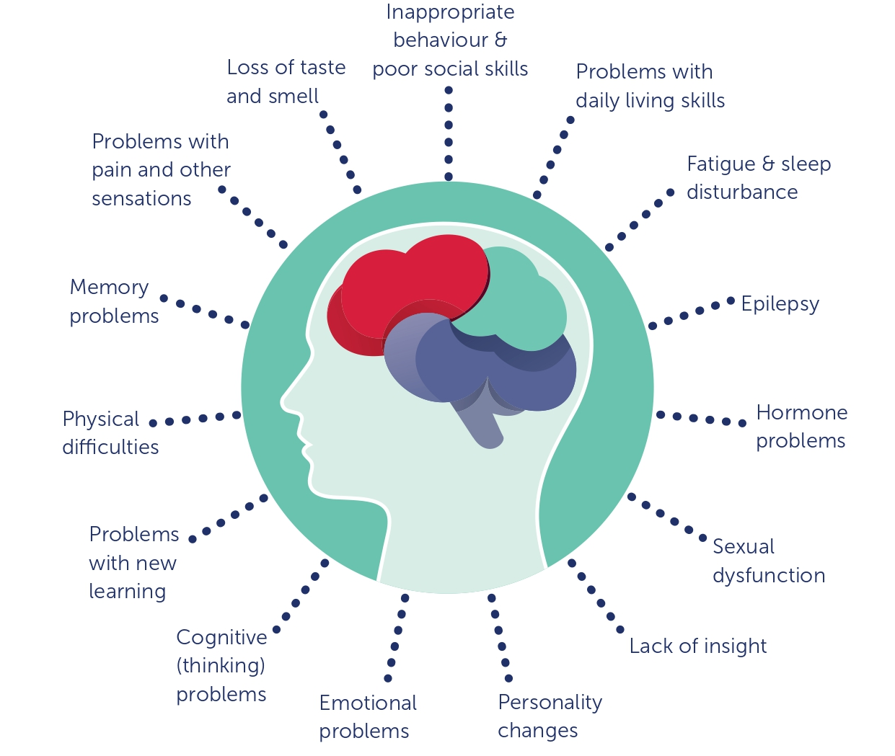
After Encephalitis
There are lots of changes that can happen after encephalitis
The ones that I often experience are…

Slide 9
How can you help me?
3 things that would help me
[x]
[x]
[x]
Notes:
Here are some suggestions:
Tell a friend about Encephalitis.
Wear red for a day to raise awareness.
Start a fundraiser!

Slide 10
Thank you
Any questions?

